Slide 1

Vel Tech Rangarajan Dr. Sagunthala R&D Institute of Science and Technology
School of Computing
Department of Computer Science and Engineering
10211CS224 / FULL STACK APPLICATION DEVELOPMENT (JAVA)
PROJECT REVIEW : MILESTONE PROJECT – 1
Date: 25-03-2026
Real-Time Event Synchronization Engine
SDG: 9-Industry,Innovation and Infrastructure
Presented By:
s.pravallika – VTU25243 – 23UECS0510
Courses Handling Faculty:
Dr. S. Hemamalini, Assistant.Professor
(Sr Grade)-M.E,ph.D

Slide 2
INTRODUCTION
1
Event management in colleges often involves manual registration, which can be time-consuming and difficult to track. This project aims to create a digital platform for managing technical and non-technical event registrations efficiently. The system allows participants to register for different events through an easy-to-use web interface. It also provides a real-time dashboard for organizers to monitor registrations instantly. Using technologies like HTML, CSS, JavaScript, Node.js, and Socket.IO, the system updates participant data live without refreshing the page. This improves accuracy and reduces manual work. Such systems are useful for managing college fests, workshops, and competitions. The Aura Event 2026 system demonstrates how real-time web technology can simplify event management.
2
3
4
5
6
7
8
9

Slide 3
PROBLEM STATEMENT
Many college event systems still rely on manual or delayed registration processes, making it difficult to manage participant data efficiently.
Event organizers often face challenges in tracking registrations and updating information across different event pages.
Without real-time synchronization, participant data may not be updated instantly, leading to confusion and data inconsistency.
Managing multiple events such as technical and non-technical competitions becomes complex without a centralized system.
Traditional systems also lack a live dashboard to monitor registrations instantly.
Therefore, there is a need for a Real Time Event Synchronization Engine to manage event data dynamically.
The system should ensure instant updates of registrations across the platform.
This will help organizers monitor events efficiently and improve overall event management.
1
2
3
4
5
6
7
8
9

Slide 4
OBJECTIVE(S)
1
To design and develop a Real Time Event Synchronization Engine that allows participants to register for technical and non-technical events through an online platform.
To implement a live dashboard system that synchronizes and displays event registration data instantly for efficient monitoring by organizers
2
3
4
5
6
7
8
9

Slide 5
PROPOSED SYSTEM
The proposed system is a Real Time Event Synchronization Engine designed to manage event registrations through an online platform.
It allows participants to register for technical and non-technical events using a simple web interface.
The system uses Node.js and Socket.IO to synchronize registration data instantly across different pages.
A live dashboard displays participant details and registration counts in real time without refreshing the page.
This solution eliminates manual data entry, delays, and errors present in traditional event management systems.
The system ensures centralized data storage and automatic updates whenever a new participant registers.
It improves efficiency, accuracy, and real-time monitoring for event organizers.
Compared to existing systems, it provides faster data updates, better organization, and an improved user experience.
1
2
3
4
5
6
7
8
9

Slide 6
PROPOSED SYSTEM ARCHITECTURE
1
2
3
4
5
6
7
8
9

Slide 7
WORKFLOW
(Add dataflow diagram)
1
2
3
4
5
6
7
8
9

Slide 8
TECHNOLOGIES USED
Frontend
HTML5 – Used to design the structure of the web pages such as registration, event pages, and dashboard.
CSS3 – Used for styling, layout design, and responsive user interface.
JavaScript – Handles client-side logic, form validation, and dynamic content updates.
Backend
Node.js – Used to build the server-side application and handle user requests.
Express.js – Provides routing and middleware support for managing the web application.
Socket.IO – Enables real-time communication between the client and server for live dashboard updates.
Database
In-Memory Data Storage / Server Data Array – Stores registered user details such as name, email, phone, event name, event type, and timestamp during runtime.
Tools
Visual Studio Code – Used for writing and editing the source code.
Node Package Manager (NPM) – Used to install project dependencies like Express and Socket.IO.
Web Browser (Chrome/Edge) – Used for testing and running the web application.
Hardware / Software Requirements
Hardware
Computer/Laptop with minimum 4GB RAM and internet connectivity.
Software
Node.js Runtime Environment
Web Browser (Chrome / Edge / Firefox)
Operating System: Windows
1
2
3
4
5
6
7
8
9

Slide 9
MODULE DESCRIPTION
Module 1: User Registration Management
Handles participant registration through the web interface where users enter name, email, and phone number.
The system validates the input data and allows users to select Technical or Non-Technical events for participation.
Module 2: Event Processing Module
Processes the user registration request and assigns the selected event name and event type.
The backend server built using Node.js and Socket.IO manages the event data and ensures proper processing of user inputs.
Module 3: Data Management Module
Stores participant details such as name, email, phone number, event name, event type, and timestamp.
This module manages the retrieval and updating of data for displaying in the live dashboard.
Module 4: Real-Time Dashboard & Monitoring
Displays all registrations in a live dashboard interface with total registrations, technical event count, and non-technical event count.
Using Socket.IO, the dashboard updates instantly whenever a new participant registers for an event.
1
2
3
4
5
6
7
8
9

Slide 10

IMPLEMENTATION SCREENSHOTS
1
Home Page
The Home Page introduces the Aura Event 2026 platform and provides basic information about the event.
It includes a “Register Now” button that redirects users to the registration page to participate in events.
2
3
4
5
6
7
8
9

Slide 11
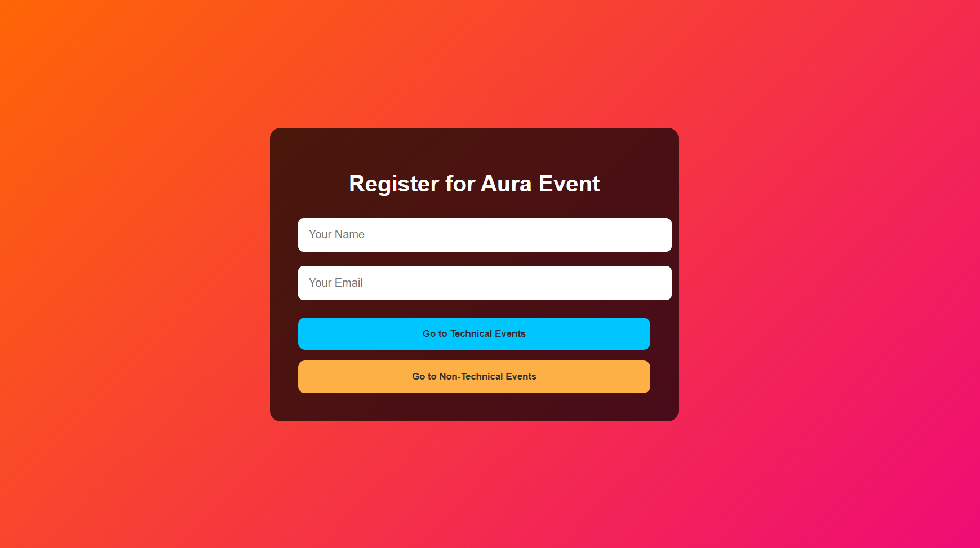
IMPLEMENTATION SCREENSHOTS
Login / Registration Page
The Registration Page allows users to enter their name and email before selecting Technical or Non-Technical events.
User details are validated and then forwarded to the event selection module.
1
2
3
4
5
6
7
8(A)
9

Slide 12
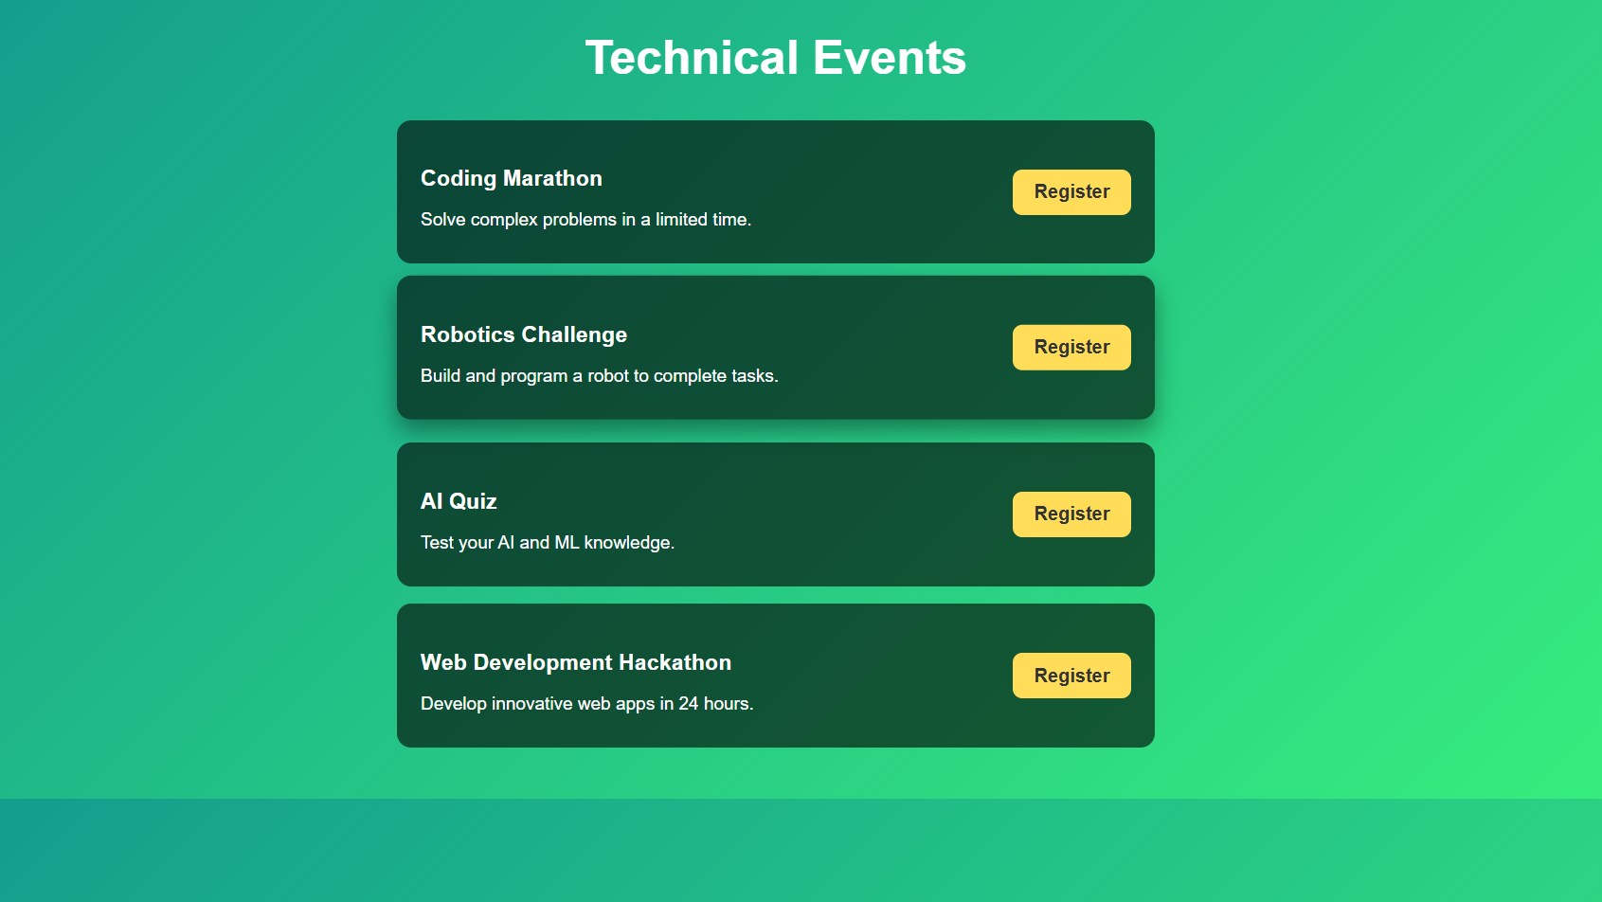
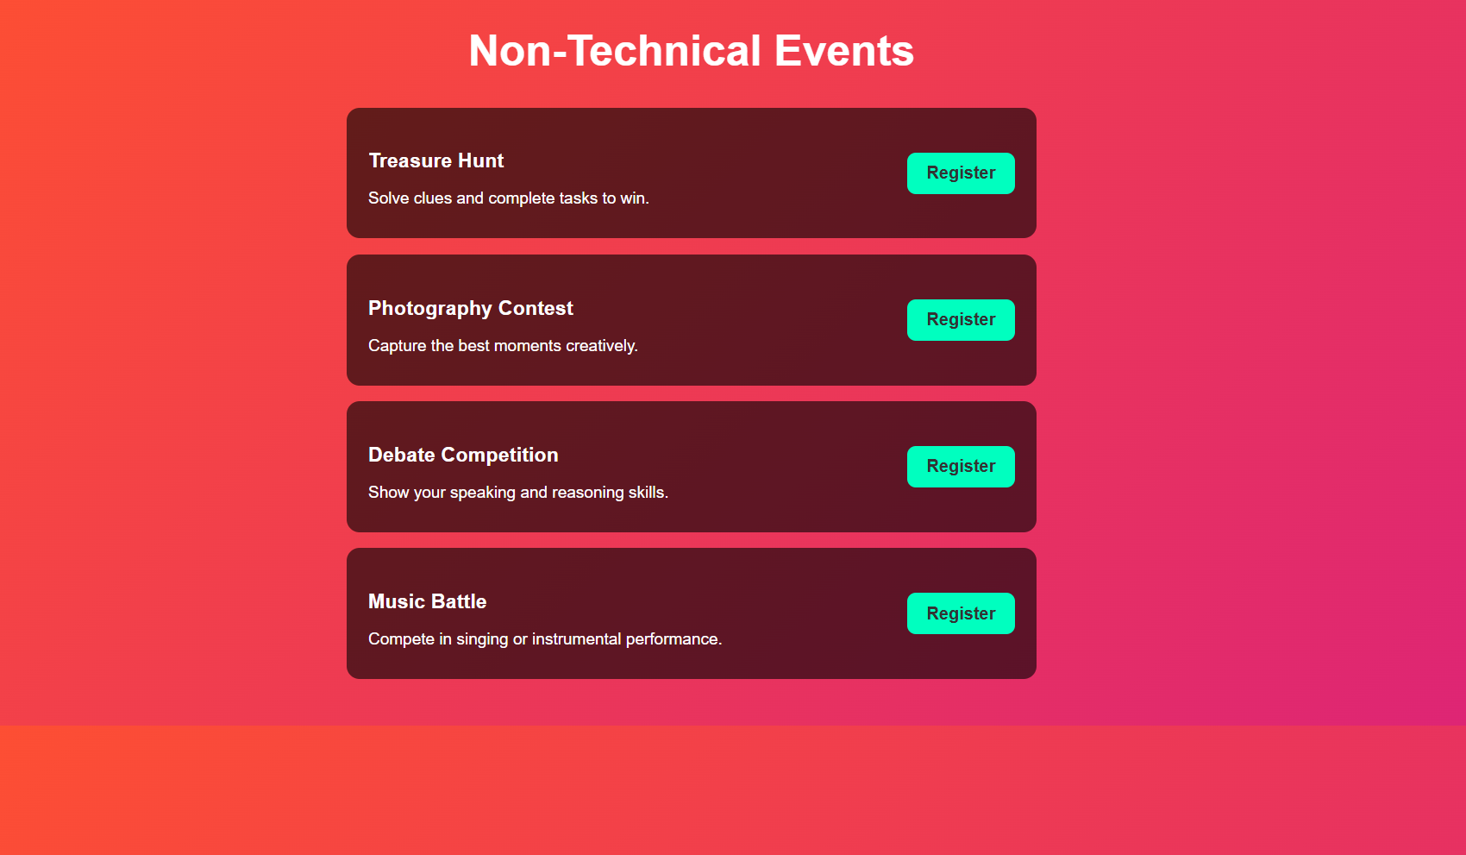
IMPLEMENTATION SCREENSHOTS
Main Module (Event Selection Page)
This module displays the list of Technical and Non-Technical events available for participation.
Users can select a specific event and proceed to register for that event.
1
2
3
4
5
6
7
8(B)
9

Slide 13
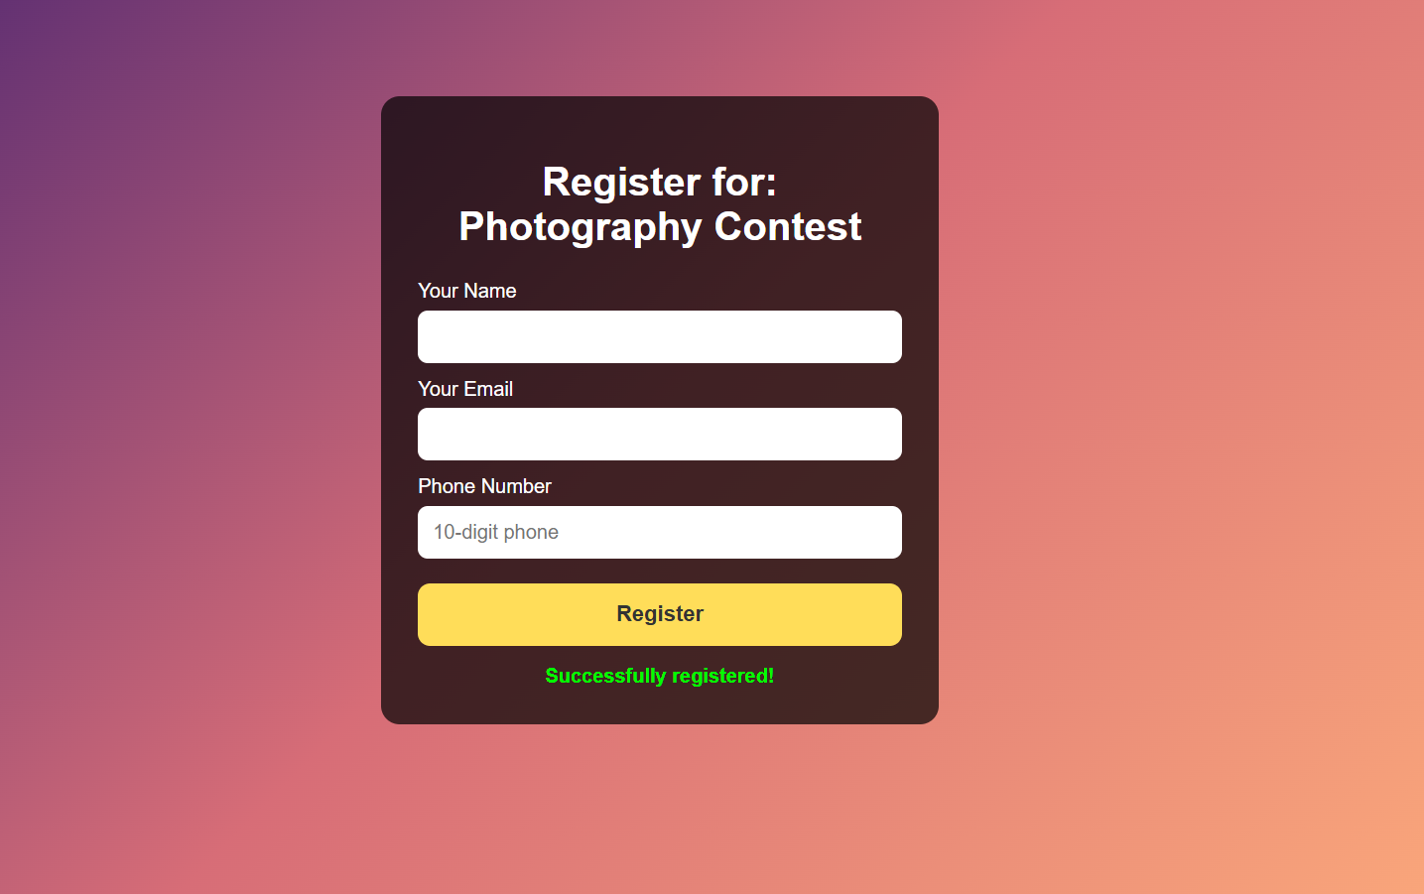
IMPLEMENTATION SCREENSHOTS
Output Page (Live Dashboard)
The Output Page displays the event registration form where users enter their name, email, and phone number to register.
After submitting the form, the system processes the data and shows a “Successfully registered” confirmation message, indicating that the participant’s details have been recorded in the system.
1
2
3
4
5
6
7
8(C)
9

Slide 14
ADVANTAGES & LIMITATIONS
1
Advantages
Real-time synchronization: Participant registrations update instantly on the live dashboard using Socket.IO.
User-friendly system: Simple interface allows users to easily register for technical and non-technical events.
Reduces manual work: Automates event registration and monitoring for organizers.
Efficient data handling: Node.js processes multiple user requests quickly.
Limitations
Basic security: Only simple input validation is implemented; advanced security features are not included.
Internet dependency: Real-time updates require a stable internet connection.
Limited scalability: The system may need optimization for handling a very large number of users.
Basic analytics: The system currently provides limited reporting and data analysis features.
2
3
4
5
6
7
8
9

Slide 15
Thank you

